Slide 1
RISK TAKING ACROSS THE LIFE SPAN
Cristina Candido, Laura Bazzigher

Slide 2
MOTIVATION
Studying the interplay between risk, gender, and age contributes to our understanding of human behavior.
Helps to gain insights into human behavior, decision-making processes, and risk preferences.
An increase in risk taking during adolescence and a decline during young adulthood is seen virtually around the world, across countries that differ markedly in cultural norms and opportunities for risk taking (Duell et al. 2018).
Among international studies with both adolescent and adult samples, findings point to a gradual decline in risk taking among both males and females (Duell et al. 2018; Mata et al. 2011).
Duell, N., Steinberg, L., Icenogle, G. et al. Age Patterns in Risk Taking Across the World. J Youth Adolescence 47, 1052–1072 (2018). https://doi.org/10.1007/s10964-017-0752-y Mata, R., Josef, A. K., & Hertwig, R. (2016). Propensity for risk taking across the life span and around the globe. Psychological Science, 27(2), 231–243. https://doi.org/10.1177/0956797615617811

Slide 3
MOTIVATION
Studying the interplay between risk, gender, and age contributes to our understanding of human behavior.
Helps to gain insights into human behavior, decision-making processes, and risk preferences.
Health
Health behavior suggests that risk perception is central to determining individual preventive behaviors (Zhao et al. 2023).
Researchers from many countries, have cited adolescent risk taking as a major public health concern (Duell et al. 2018).
Younger cyclists were more likely to engage in risky riding behaviours than their older counterpart (Twisk et al., 2015, Li et al., 2022)
Duell, N., Steinberg, L., Icenogle, G. et al. Age Patterns in Risk Taking Across the World. J Youth Adolescence 47, 1052–1072 (2018). https://doi.org/10.1007/s10964-017-0752-y Li, X., Useche, S.A., Zhang, Y., Wang, Y., Oviedo-Trespalacios, O., & Haworth, N. (2022). Comparing the cycling behaviours of Australian, Chinese and Colombian cyclists using a behavioural questionnaire paradigm. Accid. Anal. Prev., 164 (2022), Article 106471
Twisk, D.A., Commandeur, J.J., Vlakveld, W.P., Shope, J.T., & Kok G. (2015). Relationships amongst psychological determinants, risk behaviour, and road crashes of young adolescent pedestrians and cyclists: Implications for road safety education programmes Transport. Res. F: Traffic Psychol. Behav., 30 (2015), pp. 45-56
Zhao, L., Huang, H., Liu, P., Xu, L., Deng, W., Tian, F., & Tan, L. (2023). Risk perception in the era of COVID-19 and related factors among nurses: A cross-sectional study. Nursing open, 10(8), 5659–5669. https://doi.org/10.1002/nop2.1811

Slide 4
MOTIVATION
Studying the interplay between risk, gender, and age contributes to our understanding of human behavior.
Helps to gain insights into human behavior, decision-making processes, and risk preferences.
Crime
In most parts of the world, risky behavior increases over the course of adolescence before declining as individuals reach their 20s, following the “age-crime curve” that has been observed consistently across time and cultures (Eisner, 2002; Piquero et al. 2003).
Across several countries, both violent and property crime decline during the early 20s, falling off markedly after 25 years (Eisner 2002)
Eisner, M. (2002). Crime, problem drinking, and drug use: Patterns of problem behavior in cross-national perspective. The Annals of the American Academy of Political and Social Science, 580, 201–225. Piquero, A. R., Farrington, D. P., & Blumstein, A. (2003). The criminal career paradigm. In M. Tonry (Ed.), Crime and justice: A review of research (Vol 30, pp. 359–506). Chicago: University of Chicago Press.

Slide 5
MOTIVATION
Studying the interplay between risk, gender, and age contributes to our understanding of human behavior.
Helps to gain insights into human behavior, decision-making processes, and risk preferences.
Finance
Several studies provide support for the belief that aging leads to increased risk aversion and cautiousness (Peltomäki et al. 2021).
Other experimental psychological studies provide mixed findings about age-related differences in risky decisions and often find no evidence that aging would be systematically associated with less risk-taking (Peltomäki et al. 2021).
Yingkai Ma, Public opinion risk management strategy from the perspective of financial technology, Highlights in Business, Economics and Management, 10.54097/hbem.v17i.11133, 17, (165-170), (2023). Peltomäki, J., Sihvonen, J., Swidler, S., & Vähämaa, S. (2021). Age, gender, and risk-taking: Evidence from the S&P 1500 executives and market-based measures of firm risk. Journal of Business Finance & Accounting, 48(9–10), 1988–2014. https://doi.org/10.1111/jbfa.12528

Slide 6
RESEARCH QUESTION
Understanding, if risk taking-behavior over the life span is consistent
Replication of Mata et al. (2016)
Comparison of Mata et al. (2016) to data from Global Preferences Study (Falk et al., 2018)
Life span patterns of risk taking affected by hardship

Slide 7
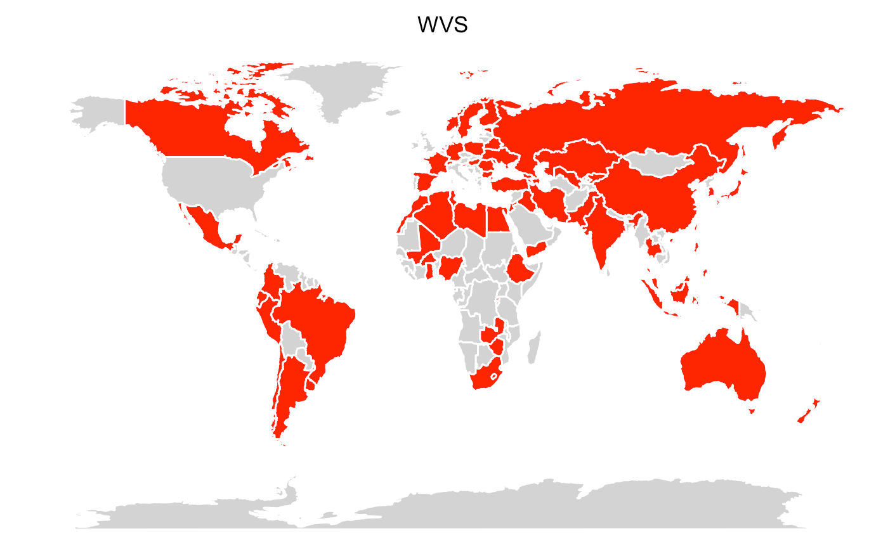
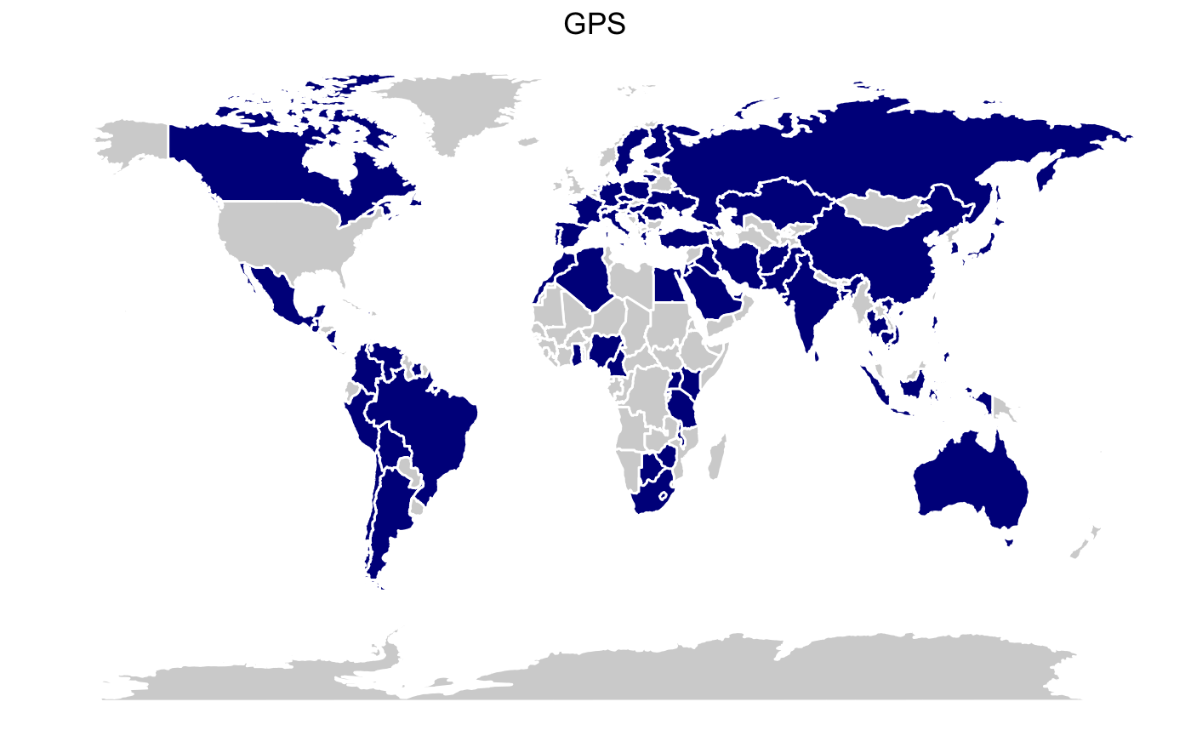
COUNTRIES
World Value Survey
Global Preference Study
Countries WVS: n = 77
Countries GPS: n = 76
Total Countries: N = 105
Overlap: n = 48
Notes:
World Value Survey
Number of participants: 156 528
males: 48%
females: 49%
WV5: 2005 - 2008
WV6: 2010 - 2014
Items: ~ 300 items
Global Preference Study
jhgjhgjhg

Slide 8
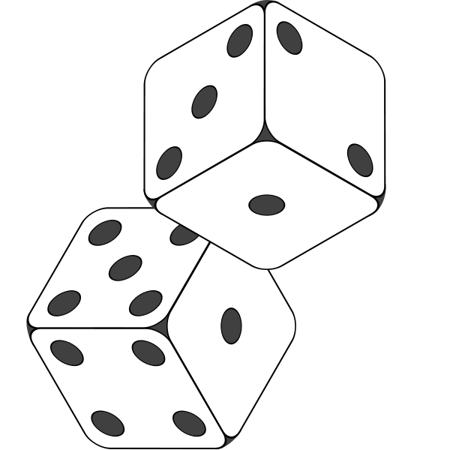
RISK TAKING MEASURES
World Values Survey
Global Preference Study
Important to this person adventure and taking risks
1.- Very much like me
2.- Like me
3.- Somewhat like me
4.- A little like me
5.- Not like me
6.- Not at all like me
Quantitative measurement = 5 binary decisions about lotteries compared to certain payments.
Qualitative question = self-assessment of the willingness to take risks on an 11-point scale.
Both qualitative and quantitative assessments were combined and weighted.
Notes:
Quantitative measurement = 5 binary decisions about lotteries compared to certain payments.
→ The lottery choice influences the amount of the next certain payment and vice versa.
Qualitative question = self-assessment of the willingness to take risks on an 11-point scale.
→ This subjective assessment has been shown to be predictive of risk-taking behavior in various contexts.

Slide 9




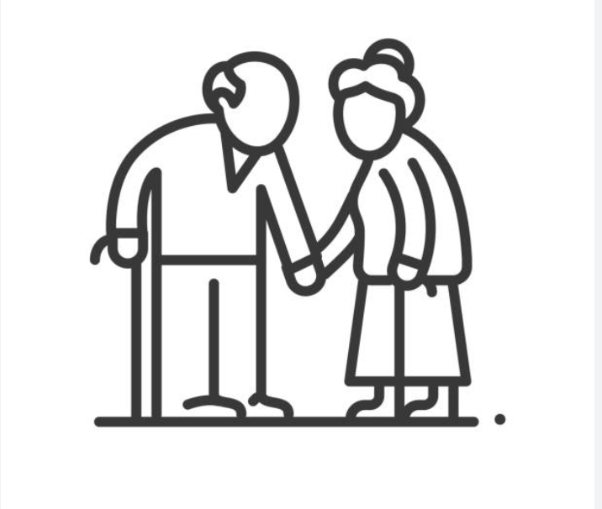
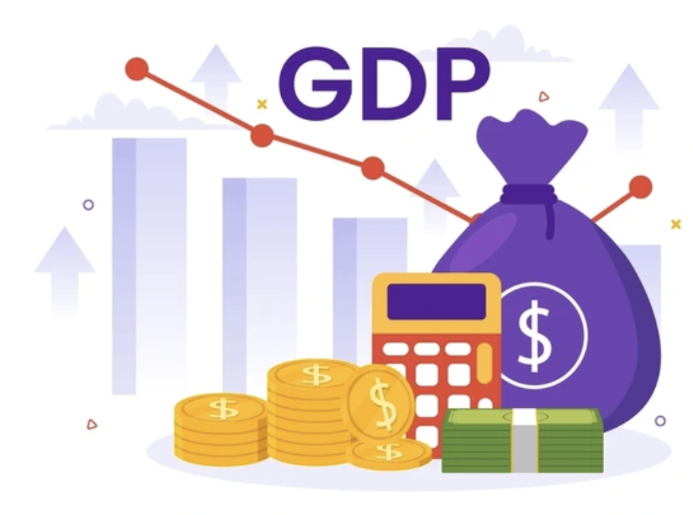
HARDSHIP
Homicide
GDP
Income Inequality
Infant mortality
Life Expectancy
World Health Organisation
The World Factbook, CIA
The World Factbook, CIA
The World Factbook, CIA
The World Factbook, CIA

Slide 10
RISK TAKING OVER THE LIFE SPAN

Slide 11
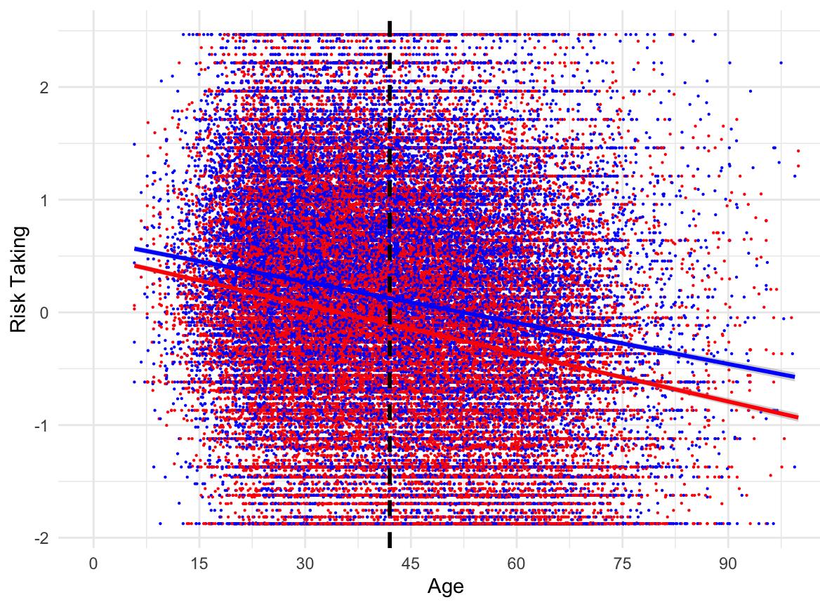
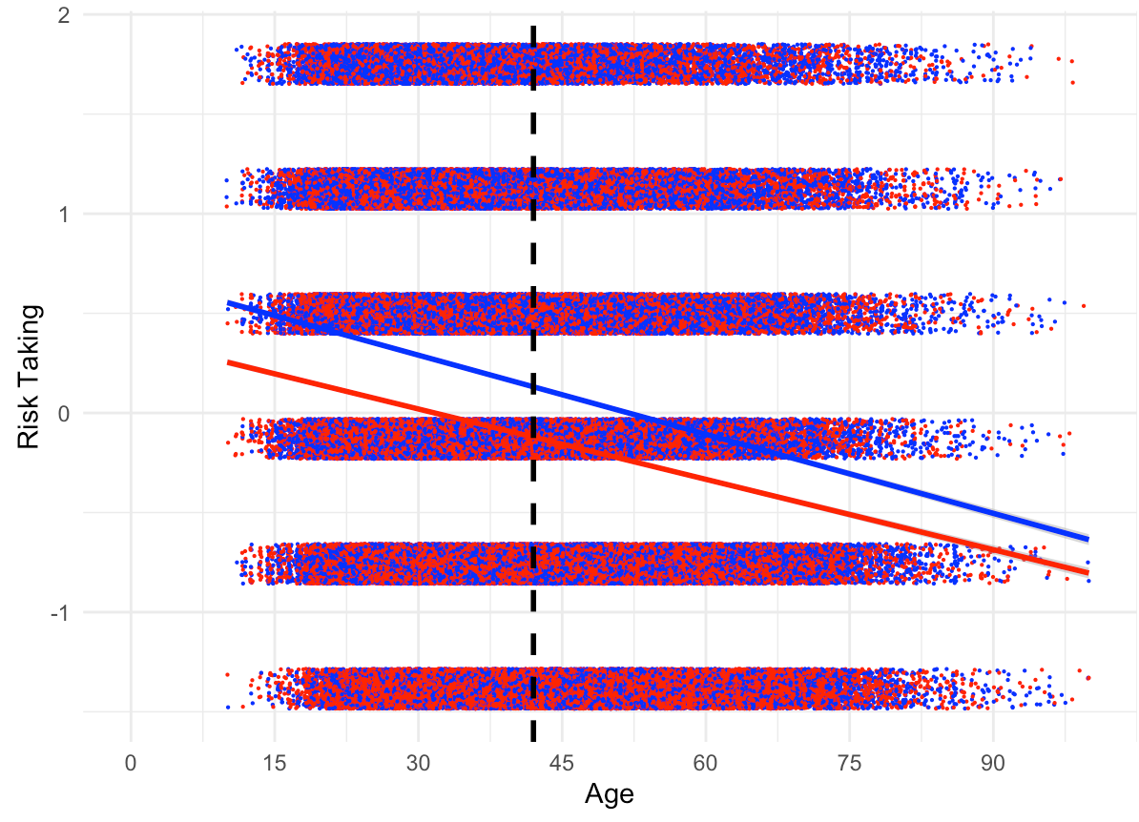
IN BOTH MEN & WOMEN, RISK BEHAVIOR DECREASES WITH AGE
World Value Survey
Global Preference Study
male
male
female
female
Adjusted R-squared: 0.05
p = .001***
Notes:
GPS: Z-Score für das Alter (z_score_age_scaled):
Estimate: -0.01326
Std. Error: 0.0002304
t value: -57.55
Pr(>|t|): < 2e-16 (sehr signifikant)
Interpretation: Der Z-Score für das Alter hat einen signifikanten negativen Effekt auf das Risikoverhalten. Ein Anstieg des Alters ist mit einem signifikanten Rückgang des Risikoverhaltens verbunden.
Geschlecht (factor(gender)): Estimate für gender = 1 (weiblich): -0.2291 Std. Error: 0.0069383 t value: -33.02 Pr(>|t|): < 2e-16 (sehr signifikant) Interpretation: Der Geschlechtsfaktor (weiblich) hat einen signifikanten negativen Einfluss auf das Risikoverhalten im Vergleich zu Männern.
Intercept:
Estimate: 0.6825 (The estimated average risk when all other predictors are zero.)
p-Value: < 0.001 (Highly significant)
Z-Score for Age (z_score_age_scaled):
Estimate: -0.01326 (The estimated effect of age on risk behavior.)
p-Value: < 0.001 (Highly significant)
Gender (factor(gender)):
Estimate for Female: -0.2291 (The estimated effect of being female on risk behavior compared to males.)
p-Value: < 0.001 (Highly significant)
R-squared Values:
Multiple R-squared: 0.05232 (The proportion of variance in risk behavior explained by the independent variables.)
Adjusted R-squared: 0.05229 (An adjusted version of the R-squared that considers the number of predictors.)
F-Statistic and p-Value:
F-Statistic: 2193 (Overall significance of the model.)
p-Value: < 0.001 (Highly significant)
Residual Standard Error:
Standard Error Value: 0.9735 (An estimate of the standard deviation of the residuals.)

Slide 12
WVS VS GPS

Slide 13
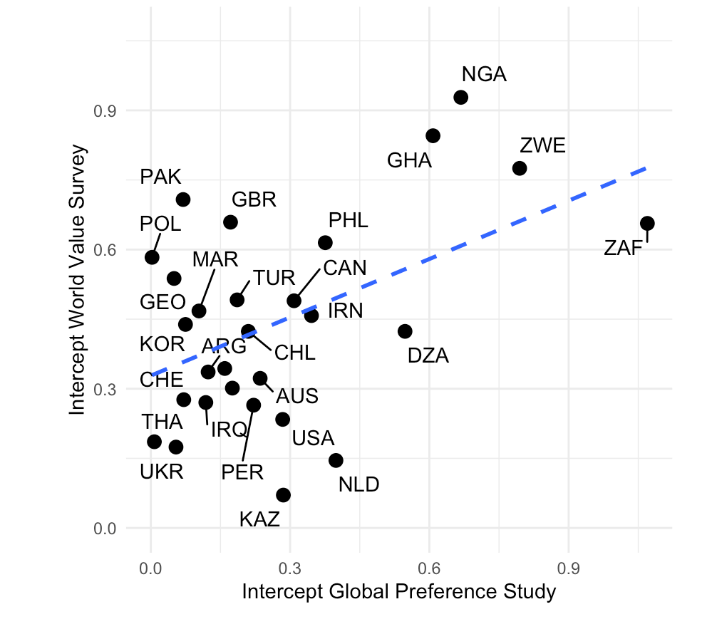
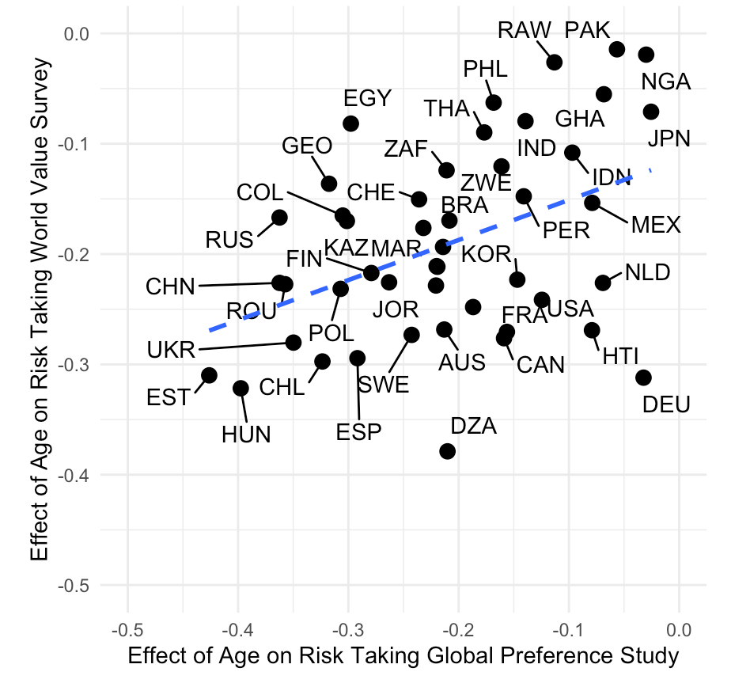
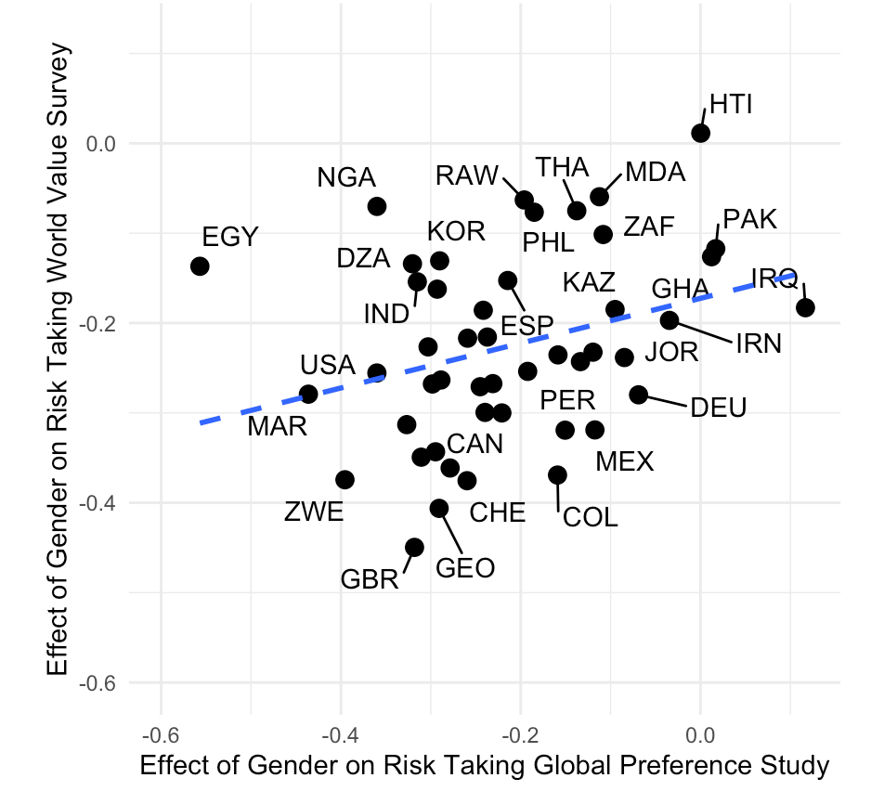
MODERATE CORRELATION BETWEEN EFFECTS OF GENDER AND AGE ON RISK TAKING
Adjusted R-squared: 0.19
p = .001***
r = 0.45
Adjusted R-squared: 0.19
p = .001***
r = 0.42
Adjusted R-squared: 0.07
p = .01**
r = 0.31
Notes:
Intercepts: 0.45
Slope age: 0.42
Slope gender: 0.30

Slide 14
HARDSHIP

Slide 15
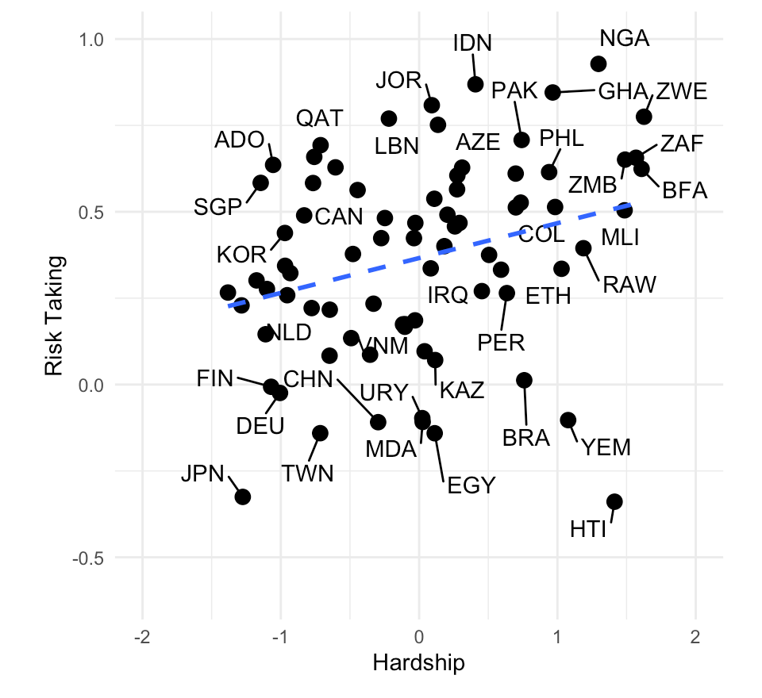
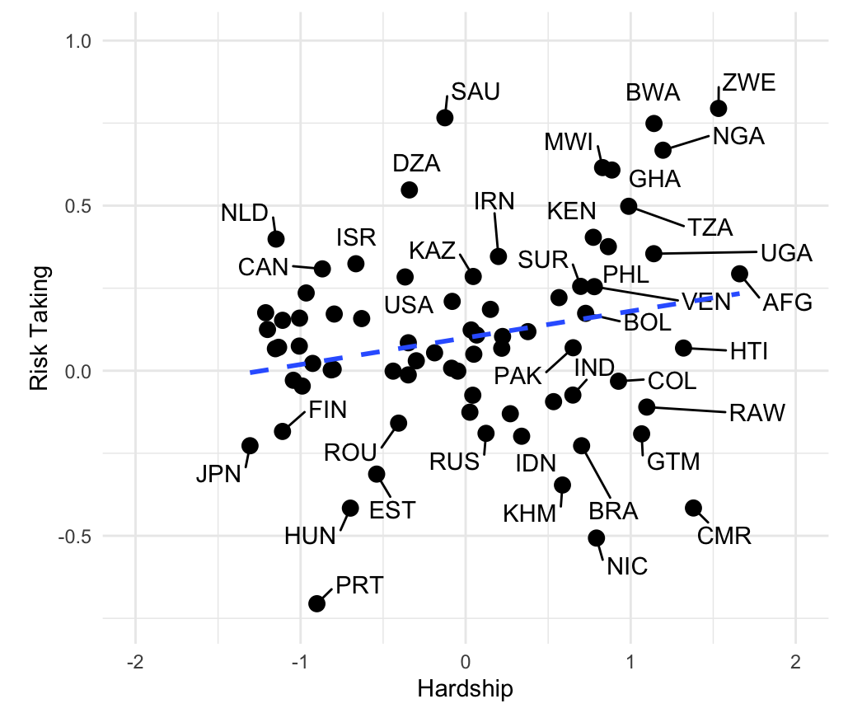
THE HIGHER HARDSHIP IS, THE HIGHER ARE THE RISK TAKING PATTERNS ACROSS COUNTRIES
World Value Survey
Global Preference Study
Adjusted R-squared: 0.07
p = 0.01*
r = 0.28
Adjusted R-squared: 0.06
p = .01*
r = 0.28
Notes:
GPS
r = 0.280361432756912
p-Value = 0.01484 *
Adjusted R-squared: 0.06598 (6.6% are explained through hardship) → Kinda low

Slide 16
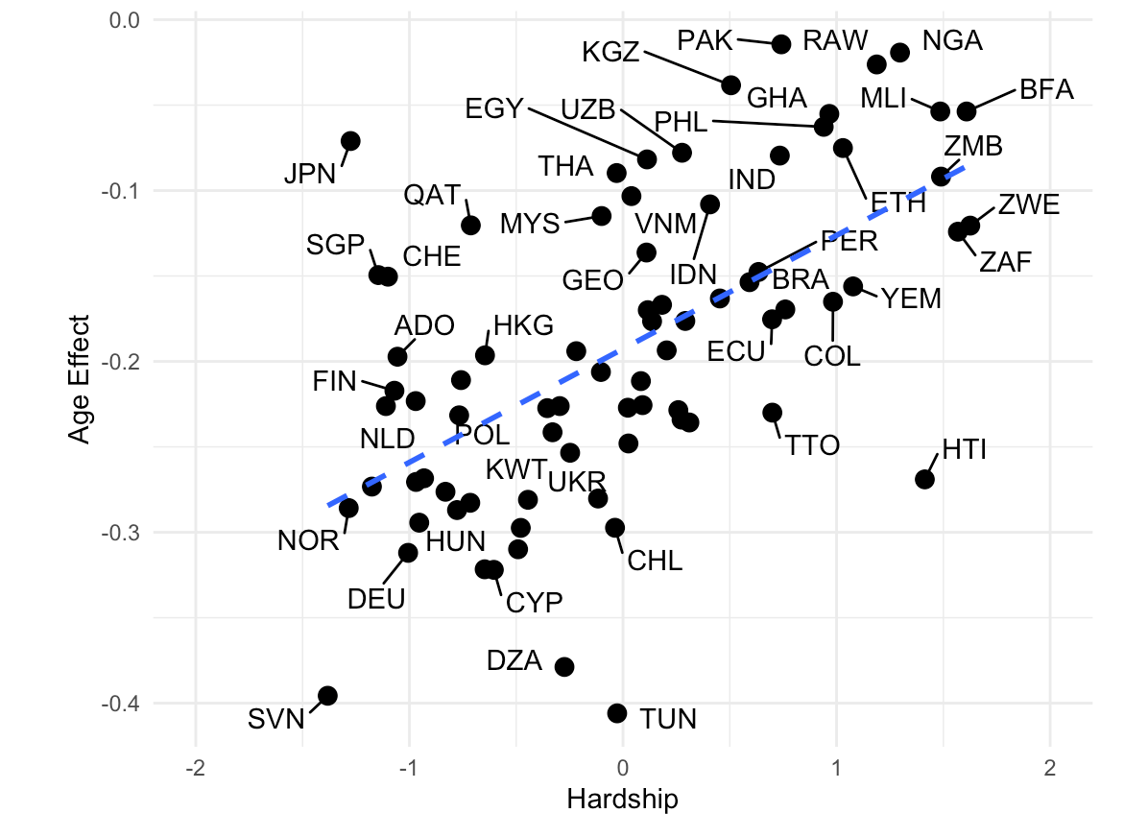
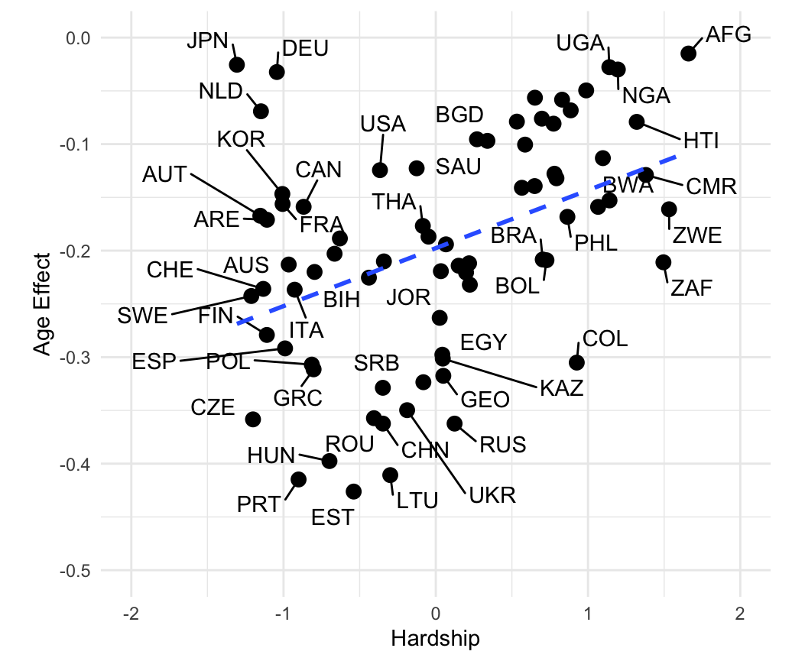
THE HIGHER HARDSHIP IS, THE LESS SIGNIFICANT IS THE AGE DIFFERENCE FOR RISK TAKING
World Value Survey
Global Preference Study
Adjusted R-squared: 0.34
p < .001***
r = 0.59
Adjusted R-squared: 0.17
p < .001***
r = 0.42
Notes:
The higher the hardship the closer are the age-gaps in risk taking
GPS
r = 0.422386769682852
p-Value = 0.0001601
Adjusted R-squared: 0.1672 (16.7% are explained through hardship) → Kinda low

Slide 17
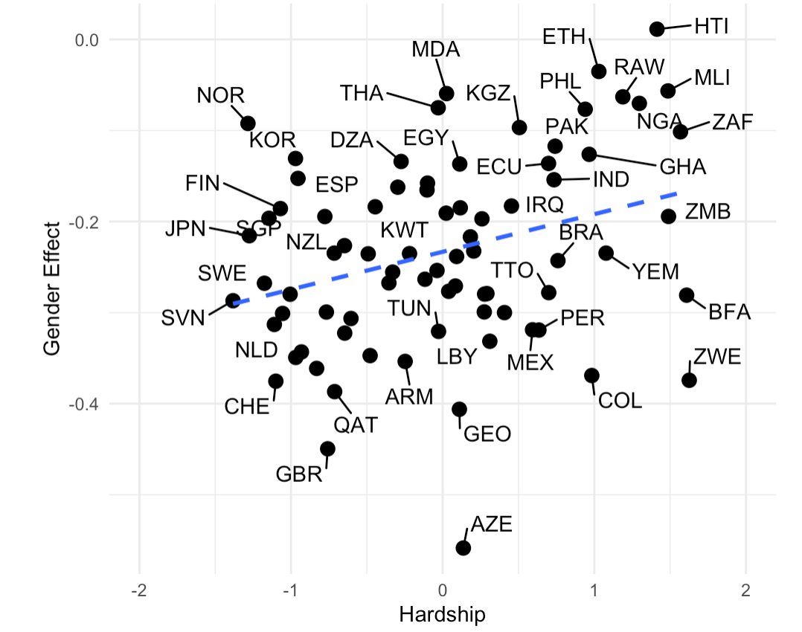
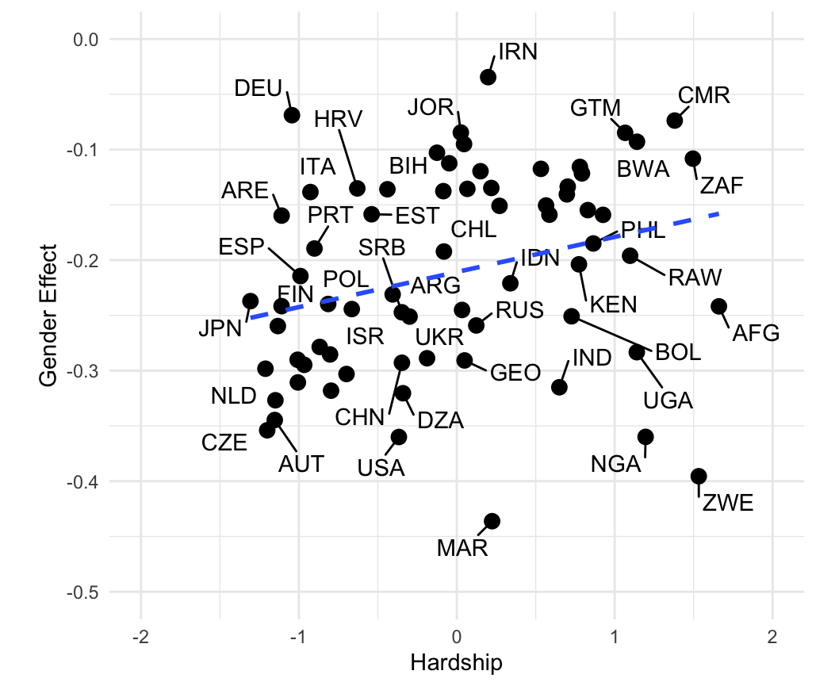
THE HIGHER HARDSHIP IS, THE LESS SIGNIFICANT IS THE GENDER DIFFERENCE FOR RISK TAKING
World Value Survey
Global Preference Study
Adjusted R-squared: 0.09
p < .001***
r = 0.32
Adjusted R-squared: 0.107
p < .01**
r = 0.42

Slide 18
LIMITATION
Hardship Index
Not the same Items as in Mata et al. (2016)
Lack of comparability
Risk Taking Measures
Temporal differences
Geographical differences
Notes:
Temporal alignment
country alignment are different

Slide 19
Conclusion & next steps
We were able to replicate the results of the Mata et al. (2016) paper
Men and young people, are more likely to take risks. However, when considering the hardship of a country, those who live in harsh environment are more likely to take risk regardless of gender and age.
Next steps?
Limit analysis to countries in common in both datasets
Incorporate data from the Global Burden of Disease
Expand data from the hardship index and work with countries indicators -> we need to get more data from the countries

Slide 20
THANK YOU

Slide 21
ROAD MAP
LITERATURE
Review the literature
World Vaulue Survey (Waves 5 & 6)
GPS
Sources for Hardship (e.g. CIA Factbook)
DATA
wrangling
visualisation
regression
ANALYTICS
Analysis Risk Taking over the life span
WVS vs. GPS
Hardship and Risk Taking
Hardship and Age
RESULTS

